Slide 1
GIT LAB TASK MANAGEMENT/DEFECT REPORTING

Slide 2
Overview
What is a Defect/Bug?
What is a Defect Life Cycle?
What status do we have for a task?
How do we change the status?
What is bug and bug reporting?
What is a task ?
Task Status
Task Assigning Parameters
Priority of a task

Slide 3
What is a Defect/ Bug?
A defect is a variation or deviation from the original business requirements
A bug is the consequence/outcome of a coding fault When a tester executes the test cases, he/she might come across the test result which is contradictory to expected result.
This variation in the test result is referred as a Software Defect. These defects or variation are referred by different names in a different organization like issues, problem, bug or incidents.

Slide 4
A DEFECT REPORT SHOULD:
Be well written.
Reproducible: make it easy to reproduce the defect by developer
Specific: be specific and to the point
Informational: add more useful information
Should have sufficient and high quality information to reproduce and fix defects in the software.
Note: The report should also enable stakeholders to make wise decisions about the defects that need to be fixed.

Slide 5
A DEFECT LIFE CYCLE
Defect Life Cycle or Bug Life Cycle in software testing is the specific set of states that defect or bug goes through in its entire life.
The purpose of Defect life cycle is to easily coordinate and communicate current status of defect which changes to various assignees and make the defect fixing process systematic and efficient.

Slide 6
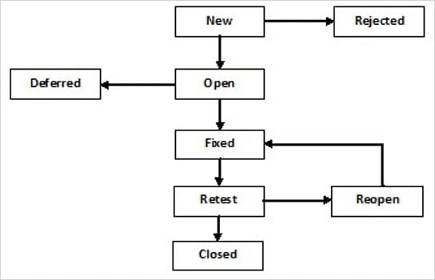
THE DEFECT STATES/CYCLE

Slide 7
A DEFECT CYCLES
New: When a new defect is logged and posted for the first time. It is assigned a status as NEW.
Assigned: Once the bug is posted by the tester, the lead of the tester approves the bug and assigns the bug to the developer team
Open/Active: The developer starts analyzing and works on the defect fix
Fixed: When a developer makes a necessary code change and verifies the change, he or she can make bug status as “Fixed.”
Verified: The tester re-tests the bug after it got fixed by the developer. If there is no bug detected in the software, then the bug is fixed and the status assigned is “verified.”
Retest: Tester does the retesting of the code at this stage to check whether the defect is fixed by the developer or not and changes the status to “Re-test.”

Slide 8
A DEFECT CYCLES cntd…
Duplicate: If the defect is repeated twice or the defect corresponds to the same concept of the bug, the status is changed to “duplicate.”
Reopen: If the bug persists even after the developer has fixed the bug, the tester changes the status to “reopened”. Once again the bug goes through the life cycle.
Rejected: If the developer feels the defect is not a genuine defect then it changes the defect to “rejected.”.A defect can be rejected for any of the 3 reasons; viz - duplicate defect, NOT a Defect, Non Reproducible.
Closed: If the bug is no longer exists then tester assigns the status “Closed.”
Deferred: If the present bug is not of a prime priority and if it is expected to get fixed in the next release, then status “Deferred” is assigned to such bugs

Slide 9
Defect Report Sample with data
Example: Defect Report for Employee Login Page
Defect id: D001
Project Name: MyASP
Module Name: Login
Sub Module Name: Employee Login
Type of Defect: Missing
Status: New
Priority : High
Summary: Employee Login Page Not Opening
Description :
Enter Url
Click On the Employee Login Option
Expected Result: Employee login page should get open
Actual Results: Employee login page does not get open
Reported By: ABC Tester
Assign To: XYZ Developer
Date & Time: 12/28/2019

Slide 10
TASKS
Basically, finalized project requirements divided into individual sections.
Tasks are created and assigned using different Task management tools such as
Gitlab
Other Defect tracking tools

Slide 11
TASK STATUS
Backlog/ Open : Task is created but not assigned.
To Do : Task has been assigned.
In progress/ Doing : Started working on the task.
Done/ Fixed : Task done by dev
Review: Ready to be tested by QA
Closed : Task Tested and Verified By QA

Slide 12
TASK ASSIGNING PARAMETERS
1. Subject
2. Description
3. Attachments
4. Assigning

Slide 13
1. Subject..
Should cover THE MODULE NAME
Should not include:
- Long Explanations and unnecessary Information
Example:
[ Profile Module] – Implement Personal Information Section

Slide 14
2. Description..
Should Contain:
A very brief explanation about the actual requirements of the tasks.
Steps to do the tasks.
Expected Result
Should Not Contain:
Informal Languages and texts
Same content as in Subjects
Deviation from subjects and unrelated issues

Slide 15
Example:
Subject:
[ Profile Module] – Implement Personal Information Section
Description:
This module should allow the users to enter the user details like First name, Last name, Permanent Address, Temporary Address, Gender…etc.
Steps:
Click on the Profile icon.
Enter the First name.
Enter the Last name.
Upload the User Image
Click on the Submit Button.
Expected Result: The user should be able to fill in the details and submit the form.

Slide 16
3. Attachments..
Can be :
Documents (SRS portions)
Design Links
Understandable by novice (new user)

Slide 17
4. Assigning..
Developer/programmer - particular project for particular purpose
Yourself

Slide 18
PRIORITY
Priority: How important it is to be done now.
Priority: High/ Medium /Low

Slide 19
Assignment
Create a Gitlab account->Project(public) and setup an issue board and create few issues/tasks with proper data. (gitlab.com)
Class Assignment: Class groupism

Slide 20
REFERENCE LINKS
Scrum VS Kanban board: https://www.lucidchart.com/blog/kanban-vs-scrum
Scrum Basics
What Is Scrum Methodology? & Scrum Project Management

Slide 21
Any queries ?
THANK YOU !

